Slide 1
HOTEL MANAGEMENT SYSTEM
PROF. HUSSAIN SYED

Slide 2
CONTENTS
INTRODUCTION
PROBLEM DEFNITION
ADVANTAGES OF COMPUTARIZED HOTEL MANAGEMENT SYSTEM
REQUIREMENT SPECIFICATION
TYPES OF DIAGRAMS
UML DIAGRAMS

Slide 3
INTRODUCTION
PURPOSE:
This computarized hotel management system is used to tell the information of the rooms which are vacant easily since it is computarized and also can be able to bill the food eaten by the customer in the hotel
The whole bill of the customer is entered into the profile untill the customer vacants the room

Slide 4
SCOPE OF THE PROJECT
The first subsystem is a Reservation and Booking System to keep track of reservations and room availability.
The second subsystem is the Tracking and Selling Food System that charges the current room.
The third subsystem is a General Management Services and Automated Tasks System which generates reports to audit all hotel operations and allows modification of subsystem information.

Slide 5
ADVANTAGES OF THE COMPUTARIZED HOTEL MANAGEMENT
Immediate access of the data.
Easily understandable options.
Time saving
Customers information profile can be easily billed.
Can easily add the new room and clear the room.

Slide 6
UML DIAGRAMS
These diagrams gives the overall information of the project in pictorial form.
The uml diagrams are as follows.
Use case.
Class diagram.
Sequential diagram.
Activity diagram.
Collaboration diagram.
State diagram.

Slide 7
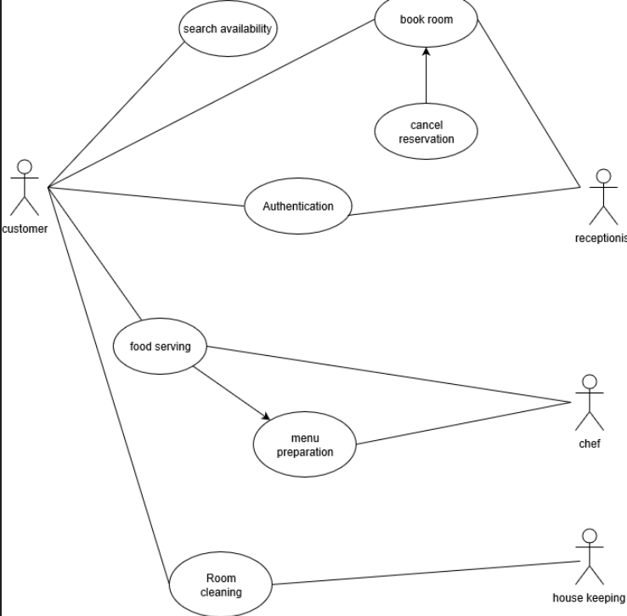
USE CASE

Slide 8
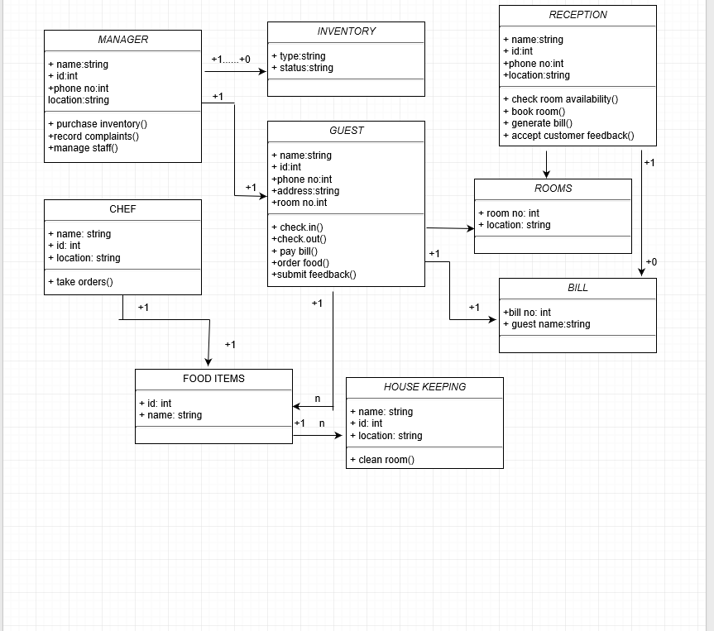
CLASS DIAGRAM

Slide 9
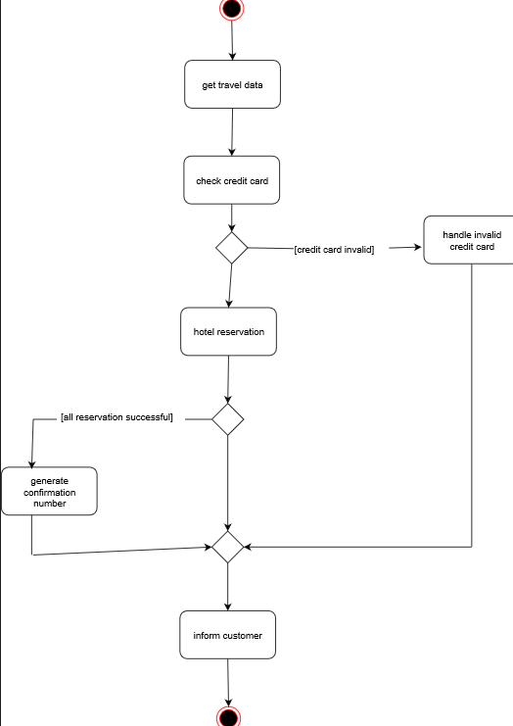
COLLABORATION

Slide 10
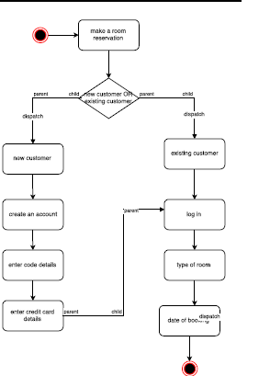
STATE DIAGRAM

Slide 11
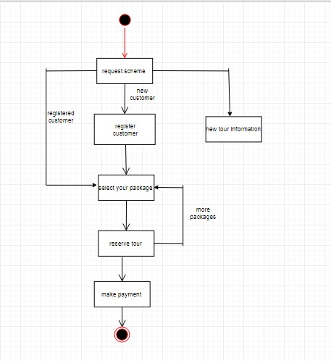
ACTIVITY

Slide 12
SEQUENTIAL DIAGRAM

Slide 13
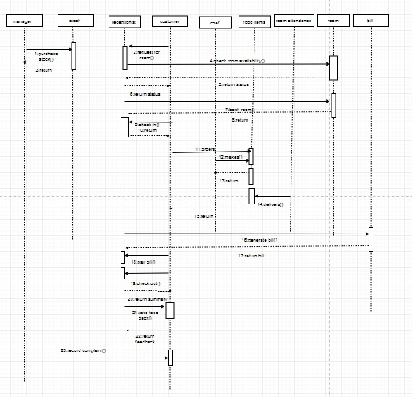

Slide 14
THANK YOU

